Slide 1
Wind Update
Beyond Static Networks To Consider Time and Space
or
Putting People Central in
Network Design and
Keeping Them In Control

Slide 2
Wind is to Mesh
as the
Web is to WAN

Slide 3
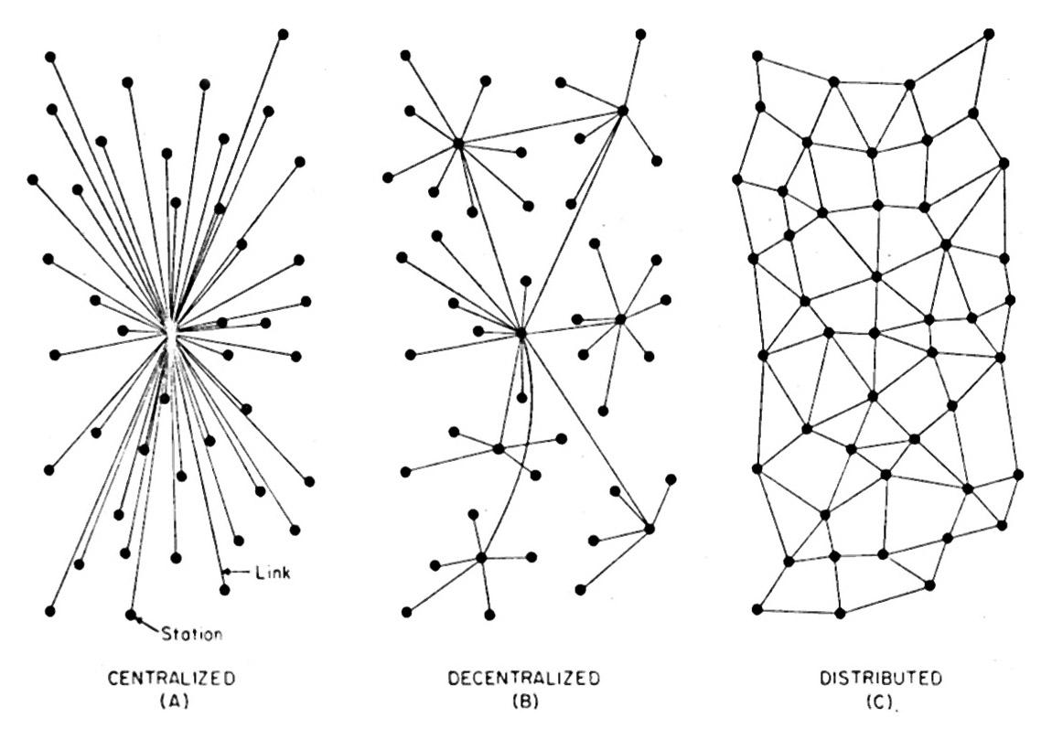
Paul Baran 1962

Slide 4
CENTRALIZED OVER TIME
Time X₀
Time X₁
Time X_{N}

Slide 5
CENTRALIZED OVER TIME AND MOTION
Time X₀
Time X₁
Time X_{N}
Place Y₀
Place Y₁
Place Y_{N}

Slide 6
DECENTRALIZED WITH CHANGE FROM
HUB TO SPOKE TO HUB OVER TIME AND PLACE
Time X_{n}
Place Y_{n}
Time X₁
Place Y₁
Static
Time X₀
Place Y₀

Slide 7
DISTRIBUTED NETWORKS
STATIC VERSUS OVER TIME AND SPACE
Time X_{N}
Place Y_{N}
Time X₁
Place Y₁
Static
Time X₀
Place Y₀

Slide 8
Wind is a kind of network that is shaped by the movements and interaction of people through time and space

Slide 9
There is no expectation of any centralized, static infrastructure

Slide 10
Wind requires no permissions by authorities or roll out of infrastructure

Slide 11
So, how could Wind work in real life?

Slide 12
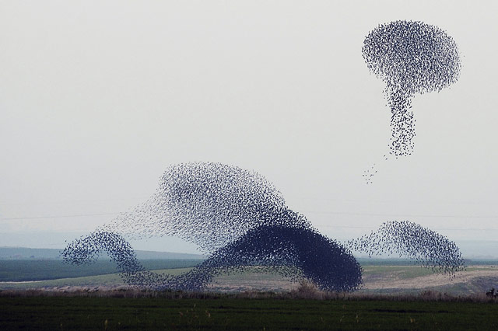
http://www.theatlantic.com/photo/2014/02/the-murmurations-of-starlings/100690/

Slide 13
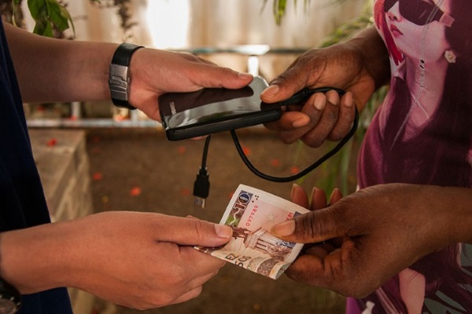
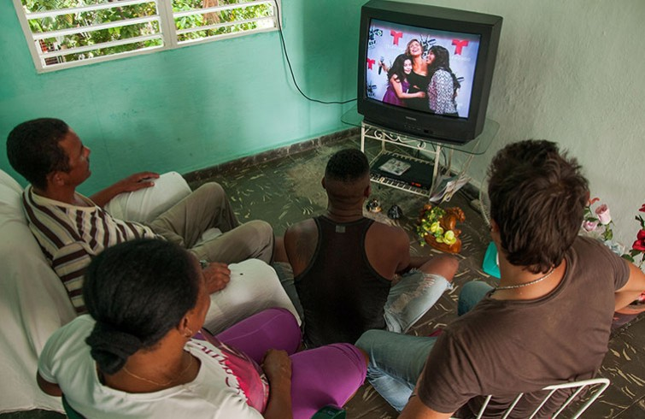

Cuba’s El Paquete Semanal “The Weekly Package”

Slide 14
THE GRIFFEY-NET aka http://librarybox.us/
8am at home
10am on the train
2pm at Fellows Hour
Jason Griffey’s “Library Box in the Backpack” Network
Centralized but Dynamic Over Place and Times

Slide 15
LIBRARY BOXEN CONTENT SYNCHRONIZATION
12pm HUB at the cafe for friends & nearby folks
10am SPOKE (sync with public library hub as you walk by)
8am HUB at home for family

Slide 16
The Temple, the Causeway and the Meetup
Causeway
Temple
Meetup

Slide 17
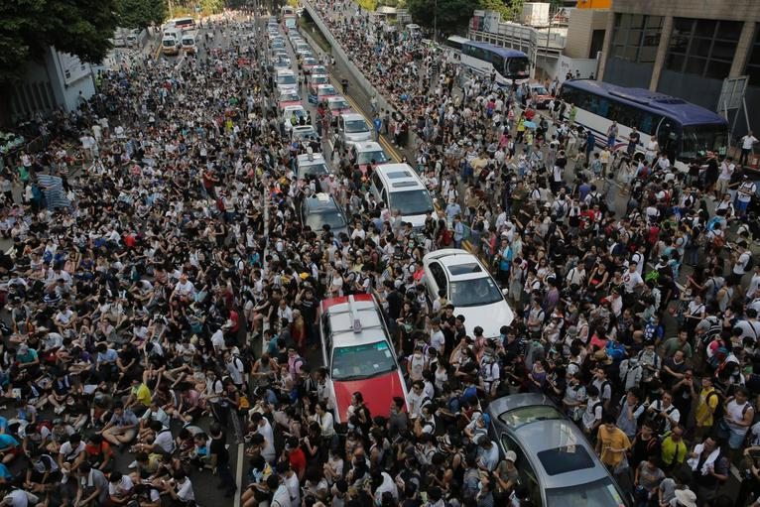
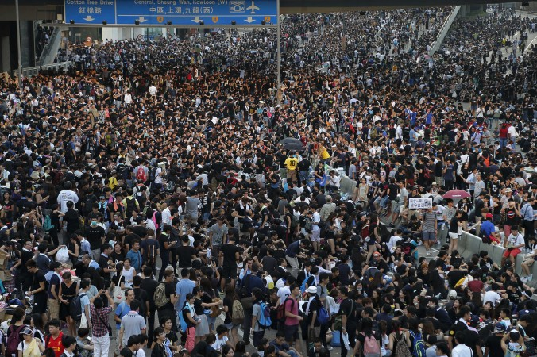
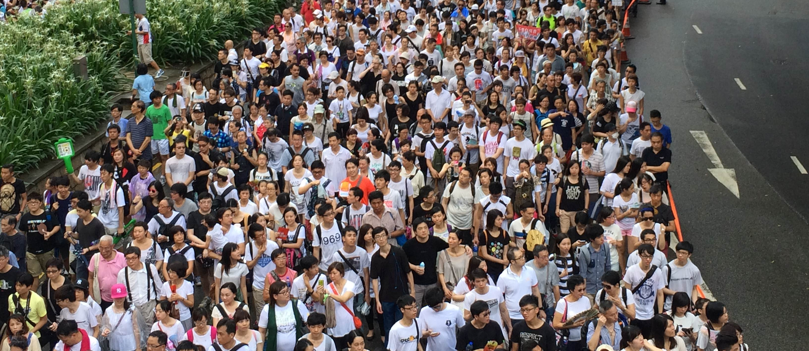

Slide 18
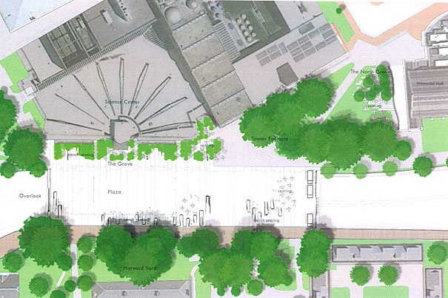
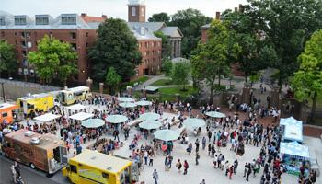
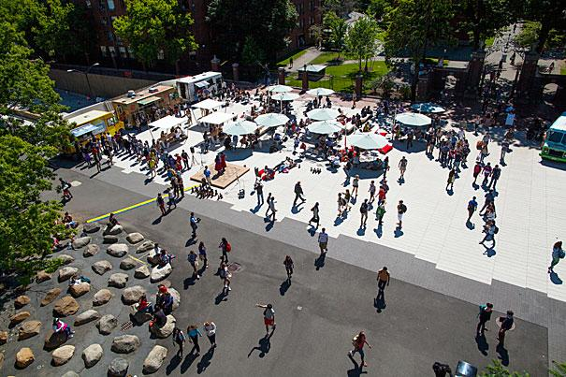
http://news.harvard.edu/gazette/story/2012/04/renewing-a-hub-of-harvard/

Slide 19
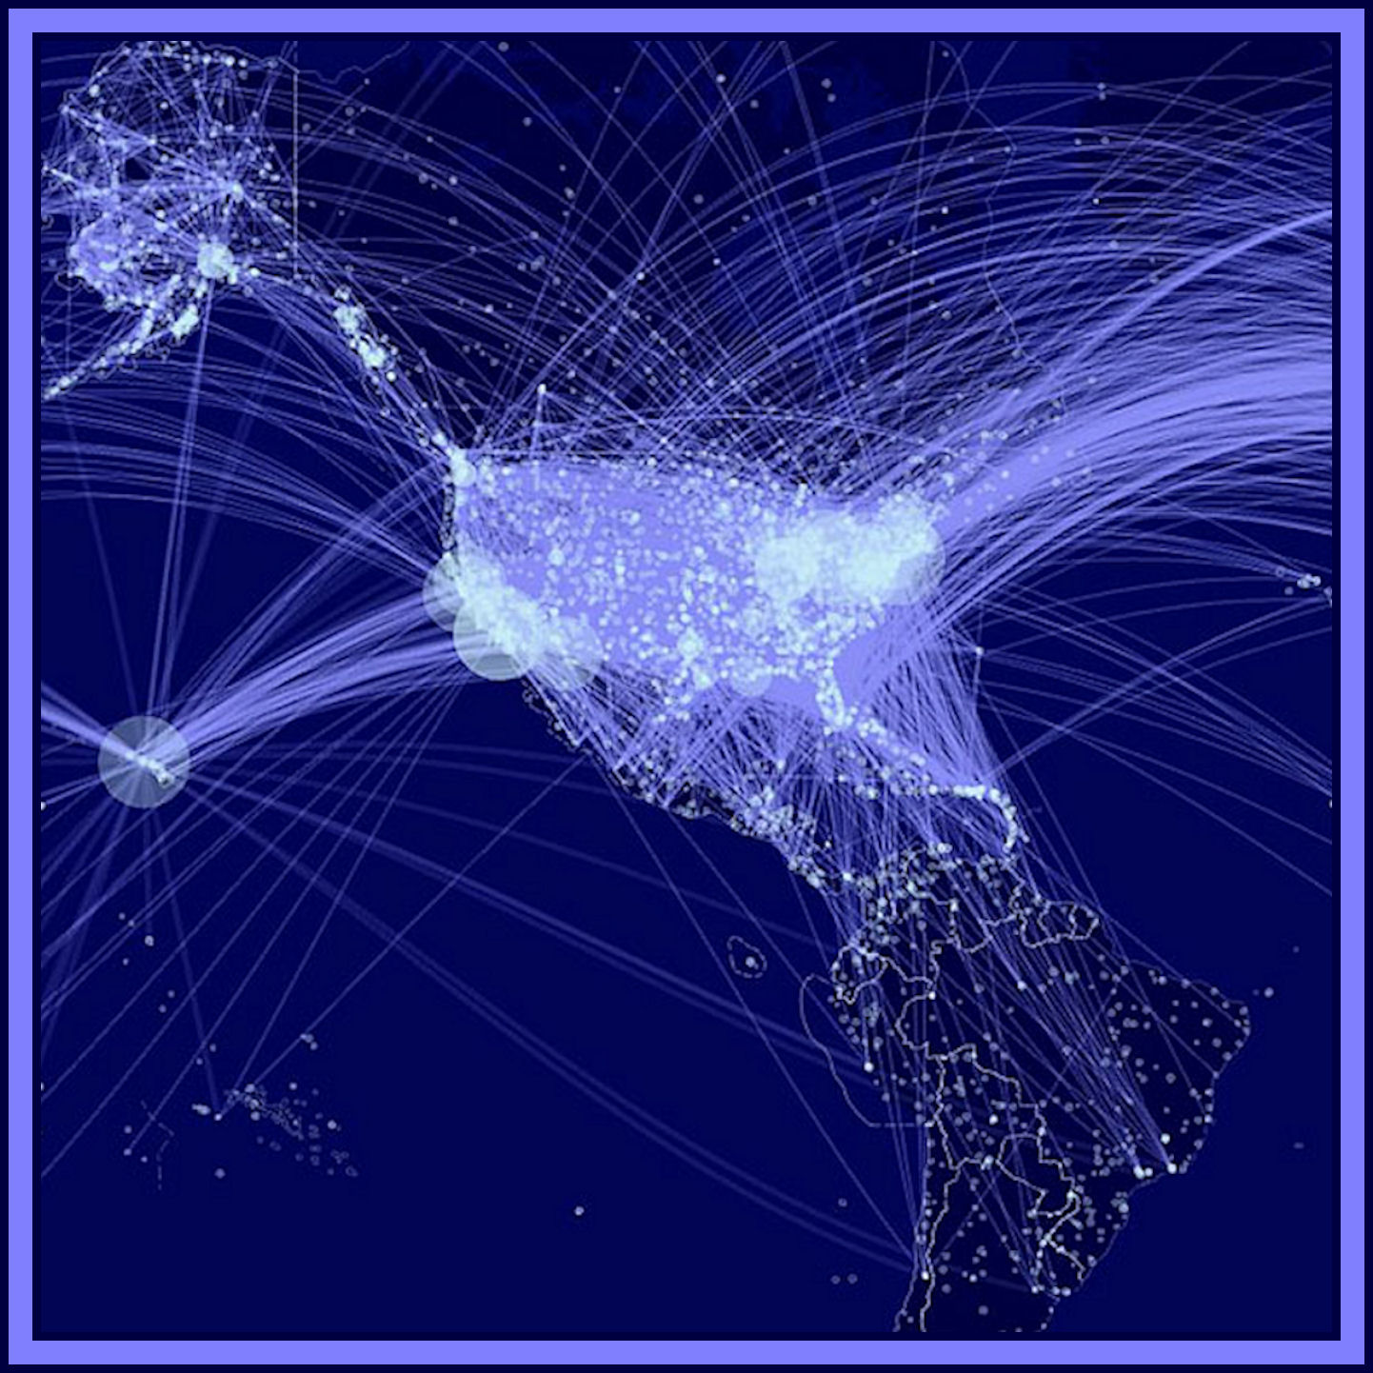
MIT Study of Airports and Infectious Disease 2012
https://scientificearthconscientious6.wordpress.com/2012/07/24/1894new-model-of-disease-contagion-ranks-u-s-airports-in-terms-of-their-spreading-influence-airports-in-new-york-los-angeles-and-honolulu-are-judged-likeliest-to-play-a-significant-role-in-the-grow/

Slide 20
The quality of a Wind network is dependent on the number of nodes connected over time and space, the density of nodes, and how their velocity and bearing is changing

Slide 21
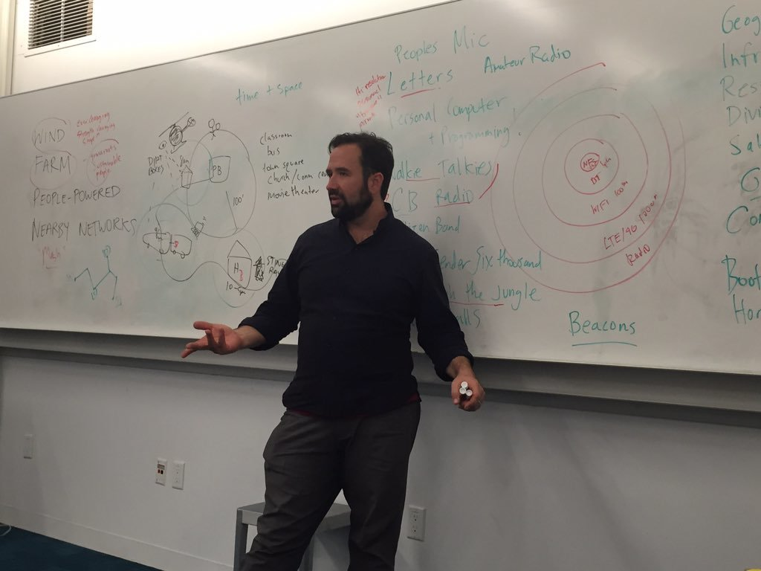
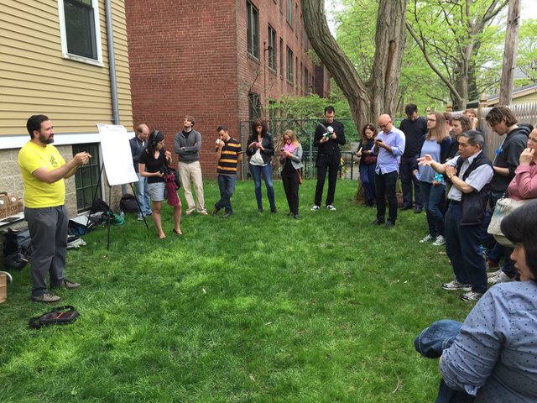
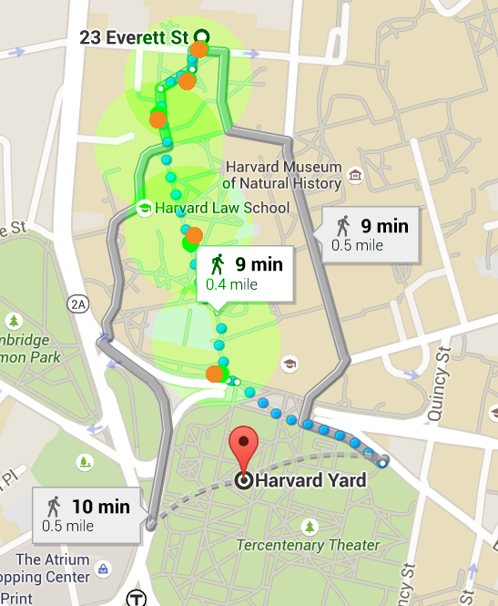
Where to from here?
Hold many, many more workshops and simulation events
Considering the cultural, economic, gender aspects on network quality, equality, sustainability, hostility
Begin to implement basic protocols for discovery & publishing
Publish design documents and patterns to help tool developers consider all the things they should be considering
https://github.com/n8fr8/windfarm https://github.com/n8fr8/gilgamesh https://talk.developersquare.net/c/developers-corner/people-powered-nearby-networks

